Slide 1

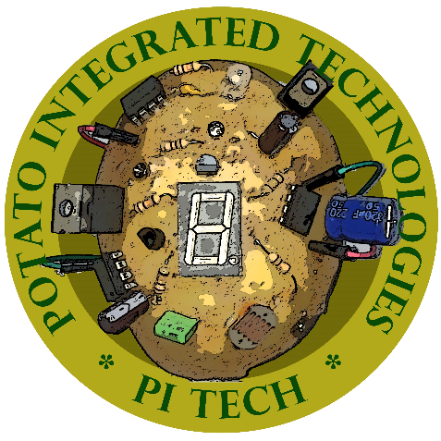
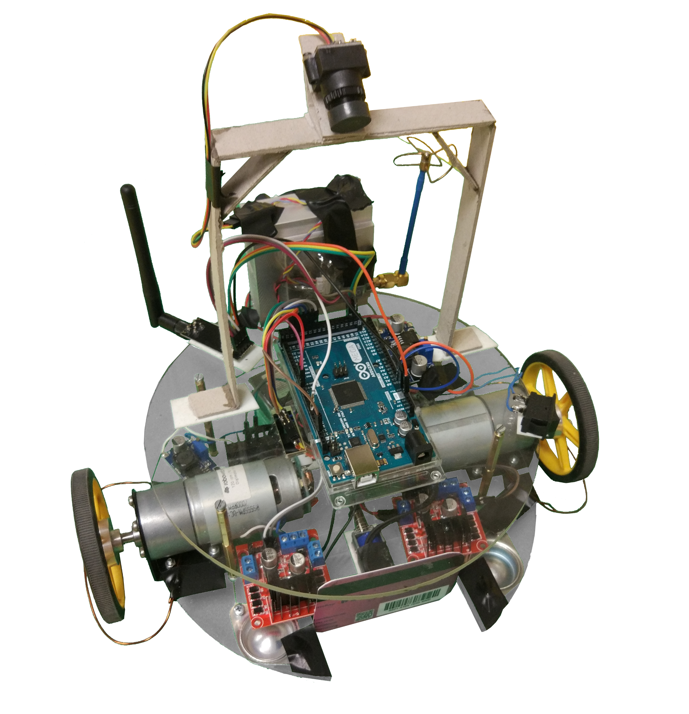
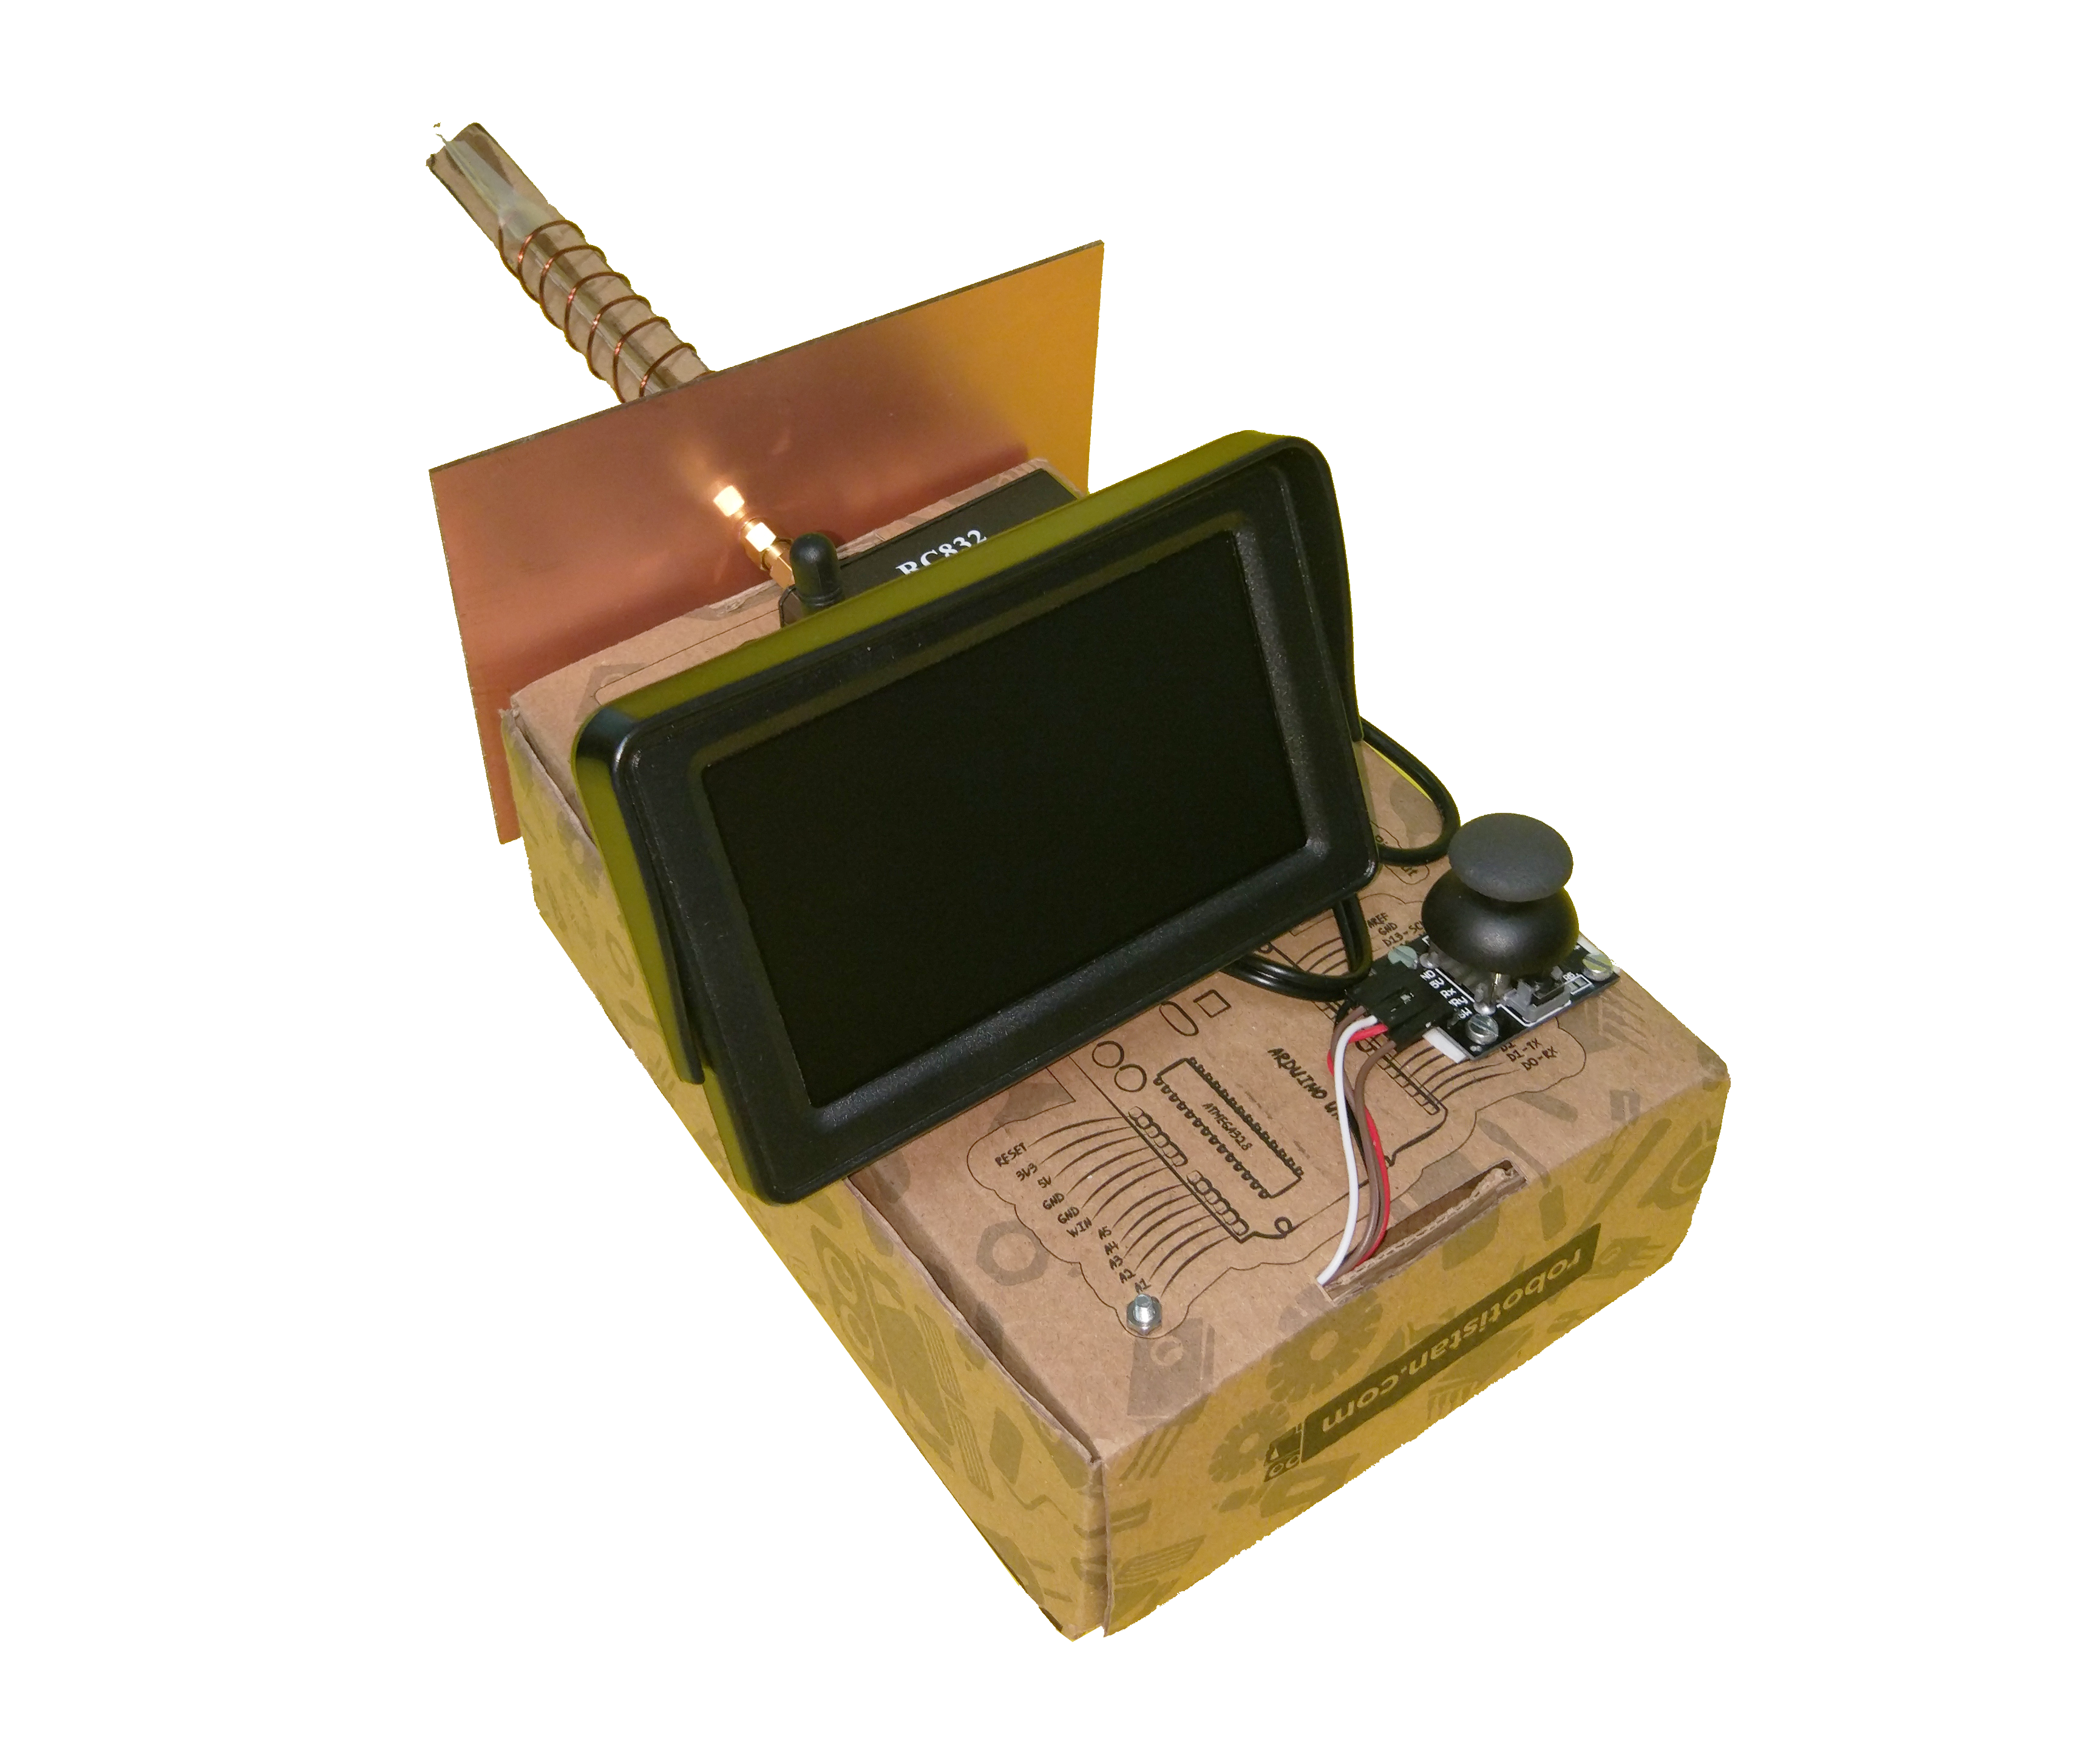
Potato: A teleoperated robot trying to
shoot and score in opponent’s goal
Fatma Nur Arabacı, Aycan Beyenir, İrem Coşkun, Furkan Bahadır Elik, Berkay Göksu
Advisor: Arzu Tuncay Koç
Electrical and Electronics Engineering Department, Middle East Technical University
PITECH (Potato Integrated Technologies) was founded in 2018 with five shareholders from different backgrounds. As PITECH engineers our aim is to build a robot that we can control from a distance up to at least 30 meter indoor with a remote controller. This robot tries to score within a playfield in its opponent’s goal and defend its own goal without actually monitoring the play-field with naked eye. It transfers the ball to opponent’s half-field in less than 20 seconds without grasping, scooping or carrying the ball.
SHAREHOLDERS
BUDGET
Fatma Nur Arabacı - CEO
Furkan Bahadır ELİK - CTO
İrem COŞKUN - COO
Berkay GÖKSU - CMO
Aycan BEYENİR - CFO
Materials |  | Cost
DC Motor with Gearbox |  | 2 x $15
L298N Motor Driver |  | 2 x $1.5
Push-Pull Solenoid |  | 1 x $4
Clone Arduino Uno |  | 1 x $4
Clone Arduino Mega |  | 1 x $10
FPV Drone Kit |  | 1 x $35
NRF24L01+PA+LNA SMA |  | 2 x $4
Joystick |  | 1 x $0.50
LCD screen |  | 1 x $30
900 mAh Li-Po Battery |  | 1 x $14
1350 mAh Li-Po Battery |  | 1 x $18
Buck Converter |  | 3 x $1
Plexiglass Chassis |  | 1 x $6
Standard Wheels |  | 2 x $2
Ball Wheel |  | 3 x $1
Cables & Connectors |  | $6
Structural connections |  | $3
Dummy Robot |  | 1 x $2
Balls |  | 2 x $0.25
Play Field Walls |  | 3 x $1
Total: |  | $189
DELIVERABLES
Potato Robot Controller Unit 2 Li-Po Battery 6 Game Field Walls 2 Balls A Dummy Robot User Manual 2-year Warranty Software Pack
OUTSTANDING FEATURES
User friendly control module
Fast-learning curve for the user
Wide field of view
TECHNICAL SPECIFICATIONS
Telecontroller Side
Physical specifications
Size (width x height x length) | 15 x 15 x 37 cm
Weight
Power Specifications
Idle Power | 8.03 W
Max Power | 8.03 W
Operation Time | 36 min
Operational Specifications
Screen Resolution | 800*480
Command Resolution | 8 bit
Robot Side
Physical specifications
Height | 27 cm
Diameter | 28 cm
Weight
Power Specifications
Idle Power | 5.63 W
Max Power | 18.83 W
Operation Time | 38 min
Operational Specifications
Maximum Forward Speed | 0.45 m/sec
Maximum Rotational Speed | 2.3 rad/sec
Method of Solution
Command Interface : Joystick Command Transfer : 2.4 GHz NRF Communication Video Transfer : 5.8 GHz FPV Communication Shooting : Push - Pull Solenoid Motion : Brushed DC Motor with Gear Box
Test Results
Customer & Engineering Requirements
$200 budget 30+ meters indoor range Robot can hit, push or otherwise drive the ball but not grasp, scoop or otherwise carry it. Robot should transfer the ball to opponent’s half-field in less than 20 seconds.

